Slide 1
Cyclistic Case study
Analysis by: Antonios Papakostoulis
Last updated: 23 July, 2023

Slide 2
Table of contents
Executive Summary
Data
Summary of the Analysis
Recommendations

Slide 3
Executive Summary
Analyzed historical trip data from July 2022 to June 2023 to identify trends in how the usage of annual members and casual riders differs.
Casual riders tend to ride for longer than annual members with duration dropping during autumn and winter.
Annual members tend to rider more on the weekdays as opposed to the weekend preference of the casual riders.
Both casual riders and annual members tend to use the bikes more during spring and summer as opposed to winter and autumn.

Slide 4
Data
Cyclistic Bike Trip Data
Data from July 2022 up to June 2023.
Data was made available by Motivate International inc. under this license.

Slide 5
Summary of the Analysis
Problem
Design marketing strategies aimed at converting casual riders into annual members.
Business Task
How do annual members and casual riders use Cyclistic bikes differently?

Slide 6
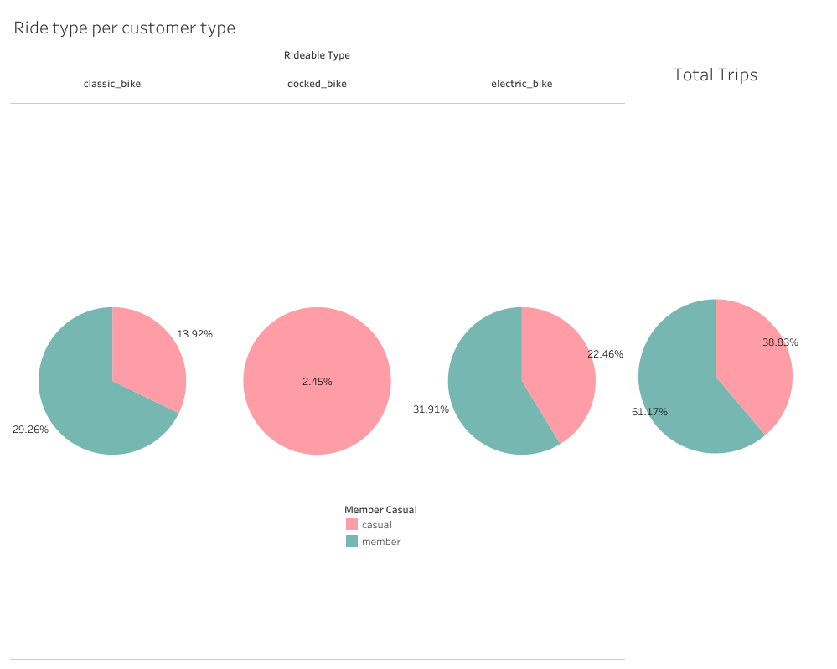
Summary of the Analysis
Casual Members prefer the electric bikes more than the classic bikes, while annual members tend to chose them both equally.

Slide 7
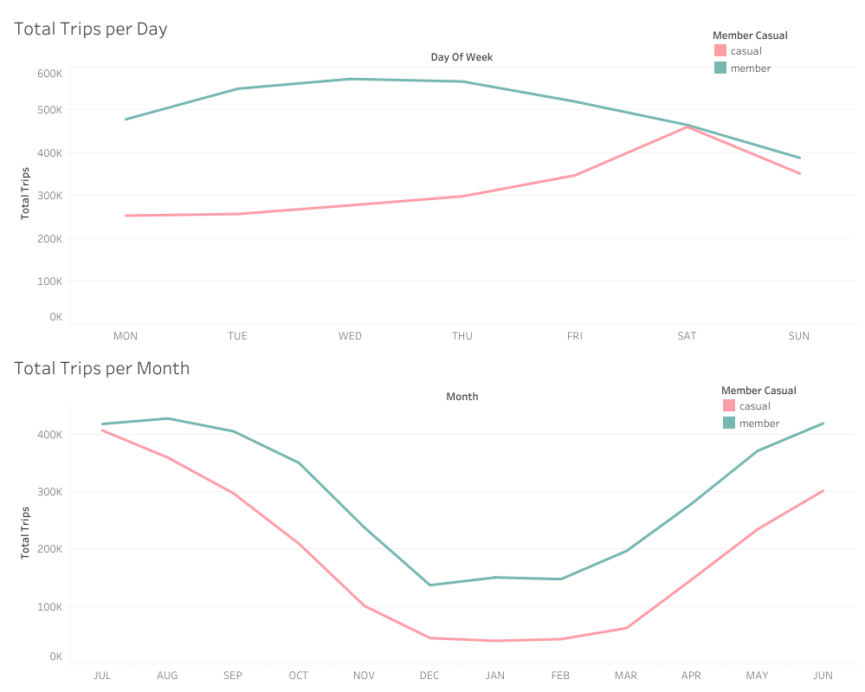
Summary of the Analysis
Casual members tend to ride more on the weekends while annual members tend to ride more during the week.
Both casual riders and annual members prefer to ride during the spring and summer months.

Slide 8
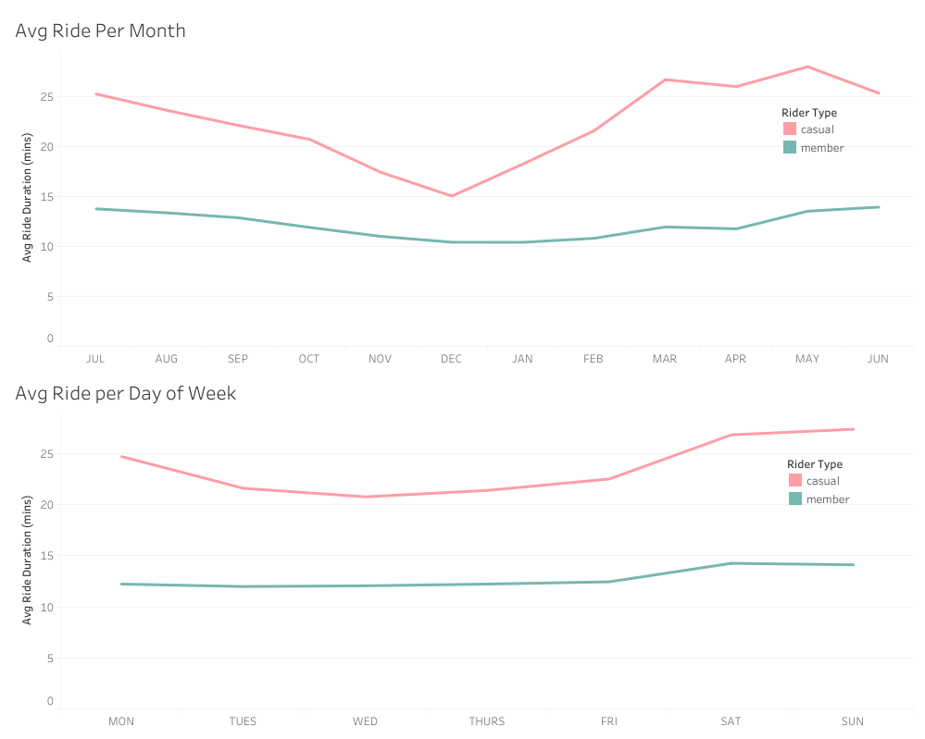
Summary of the Analysis
Casual riders tend to ride for longer periods of time throughout the whole year.
Annual members tend to ride the exact same amount throughout the week.

Slide 9
Recommendations
A marketing campaign should be created just before spring in which a discounted annual membership could be offered for the “busy” season.
Casual riders tend to ride more on weekends so a new type of membership that only applies on the weekends could be created.
An annual membership with a discount or incentive bonus based on duration of riding could be created, something that would push already annual members to ride for longer.

Slide 10
Thank you.

